Slide 1
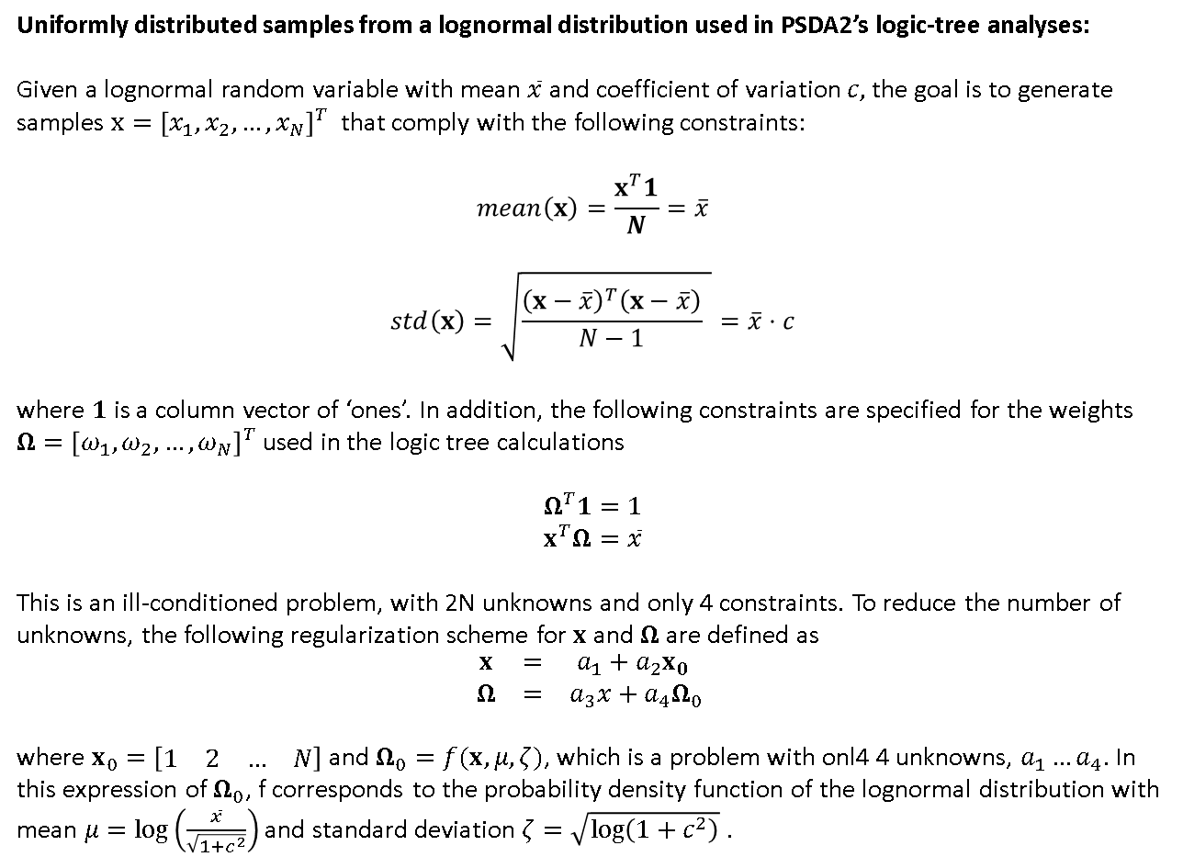
Uniformly distributed samples from a lognormal distribution used in PSDA2’s logic-tree analyses:
Given a lognormal random variable with mean $\overline{x}$ and coefficient of variation $c,$ the goal is to generate samples $x={\left[x_{1}, x_{2},…,x_{N}\right]}^{T}$ that comply with the following constraints:
$$mean\left(x\right)=\frac{x^{T}1}{N}=\overline{x}$$
$$std\left(x\right)=\sqrt{\frac{{\left(x−\overline{x}\right)}^{T}\left(x−\overline{x}\right)}{N−1} }=\overline{x}⋅c$$
where $1$is a column vector of ‘ones’. In addition, the following constraints are specified for the weights $Ω={\left[ω_{1}, ω_{2},…,ω_{N}\right]}^{T}$ used in the logic tree calculations
$$Ω^{T}1=1$$
$$x^{T}Ω=\overline{x}$$
This is an ill-conditioned problem, with 2N unknowns and only 4 constraints. To reduce the number of unknowns, the following regularization scheme for $x$ and $Ω$are defined as
$$\begin{matrix}x & = & a_{1}+a_{2}x_{0} \\ Ω & = & a_{3}x+a_{4}Ω_{0} \end{matrix}$$
where $x_{0}=\left[\begin{matrix}1 & 2 & … & N\end{matrix}\right]$ and $Ω_{0}=f(x,μ,ζ)$, which is a problem with onl4 4 unknowns, $a_{1}…a_{4}$. In this expression of $Ω_{0}$, f corresponds to the probability density function of the lognormal distribution with mean $μ=\log\left(\frac{\overline{x}}{\sqrt{{1+c}^{2}}}\right)$ and standard deviation $ζ=\sqrt{\log\left({1+c}^{2}\right)}$ .

Slide 2



% x-regularization
x = (1:Nsta)';
b = sig/std(x);
a = param(1)-b*mean(x);
x = a+b*x;
% P-regularization
P = pdf(pd,x);
on = ones(Nsta,1);
ab = [x'*P x'*x;on'*P on'*x]\[param(1);1];
dP = ab(1)*P+ab(2)*x;
$$x$$
$$Ω$$
0.1687 0.0389
0.1732 0.0481
0.1776 0.0583
0.1821 0.0685
0.1866 0.0773
0.1911 0.0838
0.1955 0.0871
0.2000 0.0871
0.2045 0.0841
0.2089 0.0786
0.2134 0.0717
0.2179 0.0642
0.2224 0.0569
0.2268 0.0503
0.2313 0.0448
In this example, 15 uniformly distributed x samples are generated using $\overline{x}=0.20$ and $c=0.10$
Notice that the set of points satifies the 4 contraints
[mean(x),std(x)/mean(x),x'*dP,sum(dP)]
= 0.2000 0.1000 0.2000 1.0000

